Slide 1


Slide 2

Advanced Functions and Recursion
Week 07 - Day 01
Atta Muhammad
attapanhyar@quest.edu.pk
+923331971110
Quaid-e-Awam University of Engineering, Science and Technology

Slide 3
Review of Functions in Python
Overview: Quick review of function definition, parameters, return values, and scope

Slide 4
Anonymous Functions (lambda Functions)
Introduction to Lambda: Brief overview of lambda functions as anonymous, one-liner functions.
Syntax: lambda arguments: expression

Slide 5
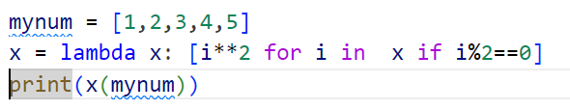
Using Lambda Functions in Python
Practical Uses: Common scenarios, like sorting, mapping, and filtering.

Slide 6
Hands-On Exercise: Sorting with Lambda
Task: Write a lambda function to sort a list of dictionaries by age.

Slide 7
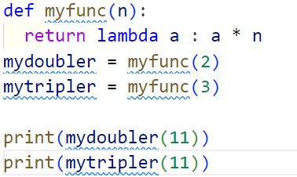
Advanced Lambda Examples

Slide 8
Functional Programming Overview
Functional programming decomposes a problem into a set of functions.
Ideally, functions only take inputs and produce outputs, and don’t have any internal state that affects the output produced for a given input.
Concepts: Introduction to map(), filter(), and reduce() functions in Python.
Why Functional Programming?: Benefits like clean, readable, and concise code.

Slide 9
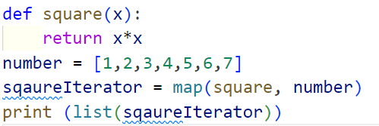
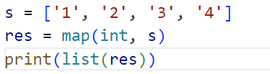
map() Function
Purpose: Apply a function to each item in an iterable.
The map() function is used to apply a given function to every item of an iterable, such as a list or tuple, and returns a map object (which is an iterator).

Slide 10
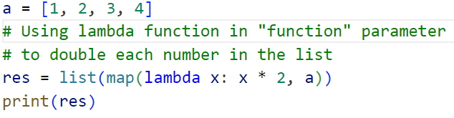
Lambda with map()
We can use a lambda function instead of a custom function with map() to make the code shorter and easier.

Slide 11

Advance Use of Map
we use map() to convert a list of temperatures from Celsius to Fahrenheit.

Slide 12
filter() Function
The filter() method filters the given sequence with the help of a function that tests each element in the sequence to be true or not.
Purpose: Filter items in an iterable based on a condition.

Slide 13
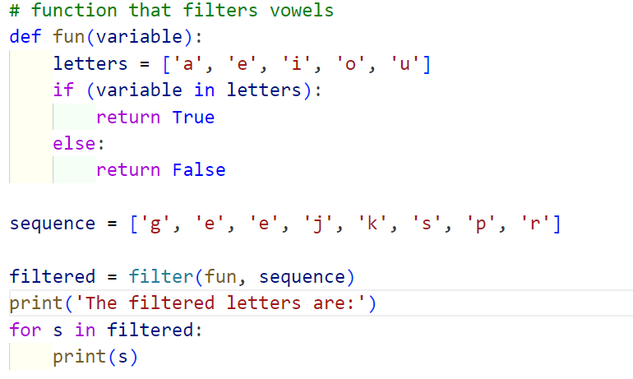
Filtering Letters

Slide 14
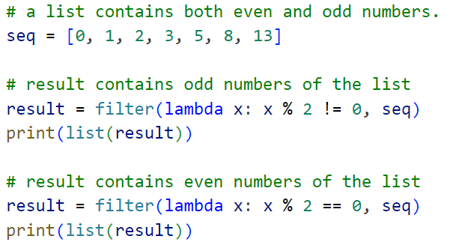
Filter Function in Python with Lambda

Slide 15
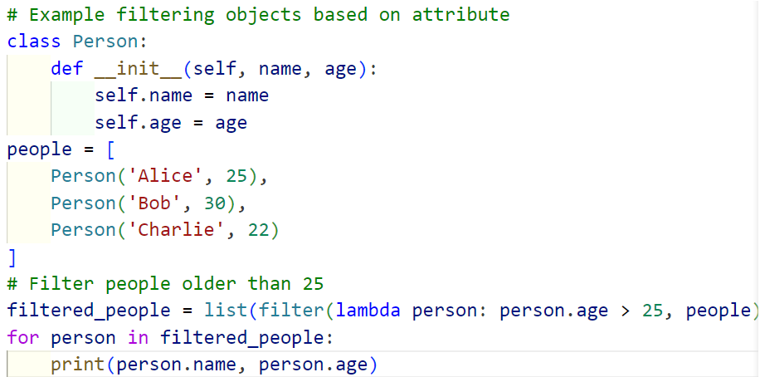
Filtering Objects

Slide 16
Introduction to Recursion
Definition: A function that calls itself to solve a problem in smaller steps.
Basic Structure:
Base case (stopping condition)
Recursive case

Slide 17
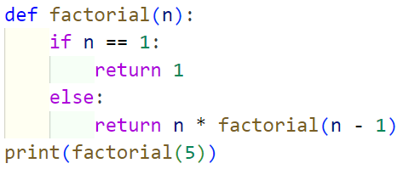
Example of a Recursive Function: Factorial Calculation

Slide 18

Understanding the Recursive Process: Fibonacci Sequence

Slide 19
Recursion vs. Iteration
Comparison: Pros and cons of recursion vs. iterative solutions.
Memory and Performance: Recursion may lead to high memory usage and stack overflow.

Slide 20
Practical Tips for Using Recursion
When to Use Recursion: Scenarios like tree traversal, directory navigation, and solving divide-and-conquer problems.
Alternatives: Iteration

Slide 21


